Slide 1

Health Chatbot- HomeBot
This presentation outlines the development of a Health chatbot designed to provide personalized health solutions for common daily life ailments.

Slide 2

Problem Statement
Many people seek quick and effective solutions for common health issues at home. However, finding reliable information can be time-consuming and confusing. A home remedies chatbot can provide instant access to accurate and trustworthy information, empowering users to self-care effectively.
Health Issues
Solution Gap
Need
Common health problems like colds and coughs are often not addressed effectively.
Many people rely on general advice, but personalized solutions are lacking.
A system providing home remedies, yoga asanas, and personalized health schedules.

Slide 3
Literature Survey
Disease_Detection_Using_RASA_Chatbot.pdf
This paper discusses the development of a healthcare chatbot using the RASA framework and machine learning for disease detection.
Technical Implementation
Framework: RASA is used for Natural Language Processing (NLP) and conversational AI.
Machine Learning Models: Various classification algorithms were implemented for disease prediction.
Features
Symptom-Based Predictions: Provides predictions for potential diseases based on user symptoms.
Doctor Appointment Bookings: Facilitates scheduling medical consultations.
Results
The chatbot successfully demonstrated the ability to provide a convenient, accessible healthcare solution.
This approach combines RASA's conversational AI capabilities with machine learning for an efficient and user-friendly healthcare assistant.

Slide 4
Home Remedies Recommender
recommender-system-for-home-remedy-IJERTV11IS040154.pdf
Objective: A website recommending home remedies for mild illnesses based on user symptoms.
Approach:
Utilized Machine Learning algorithms to suggest fruits and herbs.
Recommendations are based on symptom data, processed through machine learning models.
Key Insights:
Highlights the importance of personalized recommendations for health-related queries.
Naive Bayes provided the highest accuracy (79%-85%) for symptom classification​.

Slide 5
Voice Based Assistant
Voice-Based_Smart_Assistant_System_for_Vehicles_Using_RASA.pdf
Objective: A voice-based smart assistant for vehicles to automate tasks like navigation, weather updates, and music control.
Approach:
Built on the RASA framework using RASA NLU and RASA Core.
The bot utilizes pyttsx3 for text-to-speech and speech-recognition for speech-to-text, initializing with customizable properties like voice, rate, and volume, and processes user input upon activation through a RASA webhook for generating responses.
Uses APIs (e.g., NewsAPI, WeatherAPI) for additional functionalities.
Key Insights:
Demonstrates RASA's flexibility for intent recognition and dialogue management.
Achieved 93.67% accuracy for intent classification, showcasing robust NLP capabilities​.

Slide 6
Other Resources
Introduction to Rasa Pro - Rasa Documentation
Building and Deploying a Chatbot from Scratch using Rasa Framework: A Complete Guide for Beginners
A step-by-step Guide for Developing a Chatbot for Healthcare Apps • QuickBlox
A Developer Guide for Creating a Multi-Modal Chatbot Using LangChain Agents

Slide 7





Chatbot Flow
User Interaction
User provides input through text.
Intent Recognition
The system identifies the intent using NLP techniques.
Response Generation
The system generates a response with home remedies, yoga asanas, or a health schedule.
Health Schedule Creation
The system suggests activities based on user preferences and health conditions.
Real-Time Notification
Sends time-based notifications to remind the user of their schedule.

Slide 8
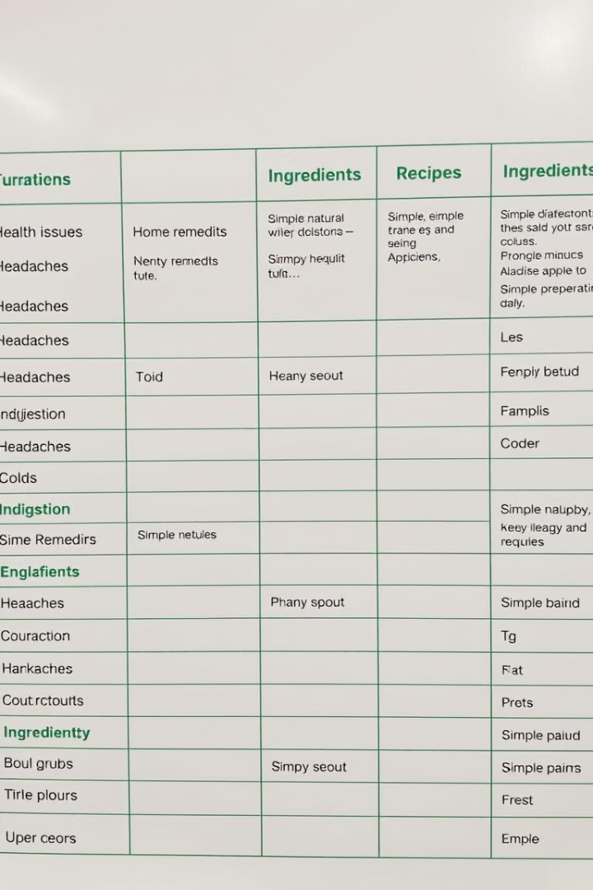
Dataset
Dataset
Kaggle Home Remedies Dataset
Content
Home remedies for various health issues
Features
Ingredients, recipes, traditional remedies, yoga asanas, and health tips
ARTICLES:

Slide 9
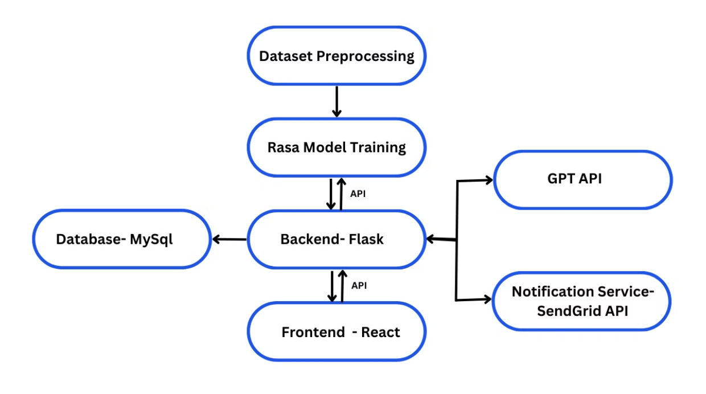
Project Architecture

Slide 10
Available Technologies
Platforms for Chatbot Building:
Technology
Pros
Cons
Fit for Project
Rasa
Customizable, open-source, supports multi-input formats, integrates with backend, multilingual support.
Complex setup, requires significant training data.
Good
Dialogflow
Easy to use, integrates well with Google services (Firebase), multi-platform support, multilingual.
Limited customization, can be expensive at scale.
Good
Microsoft LUIS
Scalable, supports deep learning models, integrates with Microsoft tools, multilingual.
Complex setup, expensive, limited non-Microsoft integrations.
Moderate
IBM Watson Assistant
Powerful NLU, integrates with APIs, customizable.
Expensive, more complex, limited community support.
Good
Hugging Face Transformers
Advanced models, flexibility, community-driven.
Requires expertise, computationally intensive.
Good (if experienced)
Twilio Autopilot
Multi-channel, integrates with Twilio services, easy to use.
Limited customizability compared to Rasa or Hugging Face, pricing.
Moderate
Amazon Lex
Integration with AWS, speech-to-text capabilities, scalable.
Limited customizability, AWS-specific.
Moderate
LangChain
Orchestrates complex workflows, integrates LLMs with external APIs, flexible.
Requires programming expertise, more complex for beginners.
Good for advanced workflows
Conclusion:
Rasa is the best fit for your health chatbot project. It offers high flexibility, customization, and full control over model training, making it ideal for handling diverse user inputs and integrating with external APIs like GPT for schedule generation. Its robust NLU capabilities and open-source nature ensure scalability and cost-effectiveness. Rasa's seamless integration with your backend and ability to manage complex workflows make it the optimal choice for your project.

Slide 11
Implementing Rasa and Training it with Dataset
Components of Rasa
Rasa NLU
Rasa Core
This component processes user messages, extracting intents (the user’s intention) and entities (specific pieces of information). It uses machine learning algorithms to understand natural language.
Responsible for managing the dialogue flow, it decides how the chatbot should respond based on the current conversation context. It uses policies to predict the next action the bot should take.
Rasa SDK
Rasa X
Allows customization of actions performed by the chatbot. Actions can include querying databases, calling APIs, or performing any other task required to fulfil user requests.
An interface for developers to improve and manage their chatbots. It facilitates data annotation, model training, and conversation exploration.

Slide 12
Steps to implement Rasa:
Setup: Install Rasa and initialize a new project using rasa init.
Prepare Dataset:
Convert your tabular dataset into YAML format with intents, entities, and actions.
Define intents such as health_issue_query, schedule_creation, etc., in the nlu.yml file.
Rasa uses the DIET (Dual Intent and Entity Transformer) model by default for intent classification and entity recognition.
The DIET model predicts the most likely intent based on training data.
Use stories.yml to define conversation paths based on user inputs and bot responses.
Add custom actions in actions.py to send notifications, request additional details, or interact with external APIs.
Train: Train the bot using rasa train. This generates a model capable of intent recognition and response generation.
Test: Use rasa shell or an HTTP API to test your bot.

Slide 13
Frontend:
React is chosen for the frontend due to its efficiency in building dynamic, interactive user interfaces. It allows seamless handling of real-time updates, user inputs (text), and ensures a smooth user experience with fast rendering.
Backend:
Flask is used for the backend as it’s lightweight, easy to set up, and highly flexible for API integrations. It allows quick deployment and handling of user requests, scheduling logic, and communication with external APIs (like GPT for schedule generation).
Database:
MySQL is chosen for storing user schedules and health data due to its structured nature, ease of use, and scalability. It supports complex queries and ensures efficient data storage and retrieval for user-specific schedules and preferences.
Why Choose These?
React offers flexibility and fast performance for user interactions.
Flask enables easy API handling and quick development.
MySQL provides a reliable, scalable solution for structured data storage and efficient querying.

Slide 14
Real-time Notifications
Service
Free Tier
SMS Features
Global Reach
Limitations of Free Tier
Best For
Twilio
Free trial credits worth $15 (for SMS, voice, etc.)
SMS, voice, email, WhatsApp, MMS, and more
Global SMS delivery in over 180 countries
$15 free credit, charges after that based on usage
Full-featured, reliable, scalable SMS services
SendGrid
Free tier includes 100 emails/day, limited SMS credits
Primarily email, but can integrate with Twilio for SMS
Global email delivery, SMS through integration with Twilio
Free tier limited to 100 emails/day, SMS integration with Twilio
Best for email + SMS combo for small-scale projects
Nexmo (Vonage)
Free trial with $2 credit for SMS and voice
SMS, voice, phone verification
Global SMS delivery
Limited free credits, charges after $2 credit is used
Good for testing and low-volume SMS needs
Textbelt
1 free SMS/day
SMS (simple API for sending SMS)
Limited global reach
Limited to 1 SMS per day, no international support
Small-scale, simple SMS notifications
Plivo
$10 free trial credit
SMS, voice, phone verification
Global SMS delivery
Free credits limited, charges after credit is used
Good for reliable, scalable SMS and voice services
SignalWire
$10 free trial credits
SMS, voice, video, phone verification
Global SMS and voice support
Limited free credits, charges after credit is used
Feature-rich, scalable communication platform
Sendinblue
300 SMS/day (limited regions)
SMS, email, marketing automation
Limited regions for SMS
Limited SMS daily quota on free plan
Best for email + SMS marketing
Conclusion:
SendGrid: Best suited for projects requiring a strong focus on email notifications, with the option to integrate SMS via Twilio. It’s ideal for applications where email communication is the primary need and SMS is supplementary. Its free tier allows you to test and manage smaller-scale projects efficiently.
Sendinblue: A great choice for projects combining email and SMS marketing automation, especially for limited regions. Its free tier offers a generous daily email limit and basic SMS capabilities, making it suitable for startups or budget-conscious projects focusing on both email and SMS communication.

Slide 15
Work Timeline
1
Week 1-2: Data Pre-processing and Rasa Training
Pre-process data, define intents, entities, and actions
2
Week 3: Backend Development
Build Flask APIs for Rasa, GPT, and MySQL integration.
3
Week 4: Frontend Development
Create chatbot UI for text inputs.
4
Week 5: Module Integration
Connect Rasa, Flask, React, and MySQL.
5
Week 6: Notifications
Implement and test notifications via SendGrid/Sendinblue.
6
Week 7: Testing
Validate end-to-end functionality and fix bugs.

Slide 16

Conclusion
1
Impact
2
Scalability
This chatbot will help users manage their health more effectively by providing personalized home remedies and real-time notifications.
The system can be extended to support more health issues, user preferences, and even other languages.
3
User Engagement
4
Future Improvements
By leveraging multimodal inputs, the chatbot ensures a more accessible and engaging experience for users.
The system can be enhanced by integrating advanced machine learning models for better personalization and recommending fitness programs, health tips, and even diet suggestions.

